Slide 1

Relational Evangelism Training
Session #1

Slide 2

Relational Evangelism Training Session #1
God does the Work
God is already at work in the people in our lives
John 4: 6-26
Notes:
“Welcome to our training on relational evangelism. We are grateful to InterVarsity for sharing their best practices with us. I’m personally excited to embark with you in getting trained together in proven ways to do good relational evangelism. I like InterVarsity’s approach to evangelism training because…..”
NOTE FOR TRAINER
The point of this session is for you to help your community “think differently” about evangelism and the world around us. You will also help them grow in expectancy and open their eyes to the ways that God is already at work. We hope they will realize that relational evangelism is a wonderful invitation for us to join in on what God is already doing. Evangelism should become a “we-get-to” adventure with God, not a burdensome “we-have-to” unpleasant duty undertaken for God.
Take 1 minute to tell them a quick story about why you are personally excited to train them using this trainings series.
If they ask what is InterVarsity,you might say,
“InterVarsity is an international college ministry movement in over 160 countries. Here in the U.S. InterVarsity has ministries on nearly 700 campuses. Over the past 20 years, they have helped over 50,00 skeptics and seekers become passionate followers of Jesus using the same principles you are about to learn. InterVarsity has gathered their best practices and most helpful trainings, and now we get this summary which they have made more church-friendly.”

Slide 3

Our 5 Trainings
Mentoring
New Believers
Invitations that
Change Lives
Asking
Good Questions
The 5 Thresholds of Faith
God does the Work
Notes:
“There are five trainings in this series. (Read the titles of all five, starting with the bottom).
As we will see, these five trainings are a helpful combination of Biblical principles about evangelism, along with very practical workshop sections in which you get to try on each of the main ideas for yourself. The goal is to equip us to live out these values.”
TIP FOR TRAINER
You and your church may decide to only offer a few of the trainings, and that is fine. Each one can be used as a “stand alone” session. You may also wish to reverse the order, given your needs. Although they have been created to build naturally upon one another, this is not required.

Slide 4
Common Misperceptions?
Professional Evangelism
Relational Evangelism
Experts Only
Everyone has a Role
Slick Presentation
Personal & Conversational
Stadium of Strangers
People close to You
One-man Show
God does the Work
Notes:
We all have different ideas and feelings about the word evangelism. In this training, we are not learning to become professional evangelists. Instead, our focus is RELATIONAL evangelism. Here are four key differences.
(click) Professional evangelism is experts only. You have to go to seminary first. (click) In relational evangelism, everyone gets to participate. Why? Because everyone has relationships!
(click) In professional evangelism, we rely on a slick presentation. (click) In relational evangelism, it is personal and conversational.
(click) In professional evangelism, we see huge stadiums full of strangers. (click) In relational evangelism, it is all about the people right around you.
(click) in professional evangelism, it is all about the gifted evangelist. (click) In relational evangelism, we look for where God is at work, and expect God to change lives.”
TIPS FOR THE TRAINER
If you have time, take two minutes, “Turn to your neighbor. Which of these four misperceptions is most relevant for you?”
If someone asks why we are against professional evangelism, feel free to say, “Jesus had lots of public sermons in front of thousands of people. Jesus loved to preach to the masses. So did the Apostle Paul. But today we will see that Jesus also was a master at relational evangelism, and that is the focus of this training. But just to clarify, both public proclamation and relational evangelism are both Biblical models.

Slide 5

What is
Relational Evangelism?
Joining with God in the ways God is already at work
in the people around us.
Notes:
“Let’s ponder the definition of relational evangelism. May I please have a volunteer to read this outloud?”
(After reading the slide) “What do you notice about this way of defining relational evangelism?” (Let someone share an observation)
Let’s remember two things for the rest of our lives.
God is already at work in everyone we ever meet.
People are eternal. Each person matters so much God, and therefore to us.

Slide 6

Jesus is amazing!
Notes:
As we are about to see in John 4, Jesus is the master of relational evangelism. He crosses all barriers. He asks good questions.
And we must remind ourselves, Jesus has given us his Holy Spirit to equip us in all things. The pressure is on Jesus, not on us. We just have to be willing, and faithful to learn and grow.
In today’s training, we will learn two things:
We will be inspired by Jesus’ approach to relational evangelism.
We will learn to pray with fresh eyes of faith.
TIPS FOR THE TRAINER
If people are feeling stressed by the concept of evangelism, after telling them the point of today’s training, say, “Everyone just take a deep breath with me: inhale, exhale. Let’s enjoy this ride together.”

Slide 7

Spiritual conversations are like….
Notes:
In John 4, we will see how Jesus does relational evangelism with the woman at the well, and how me moves this conversation through the layers of her life. She becomes curious, open, and then reveals her seeker question.

Slide 8
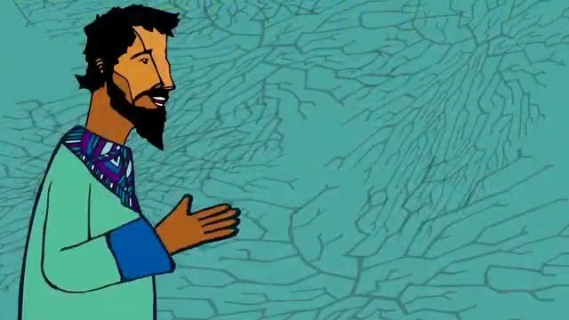
Notes:
“Now, let’s get into John 4. We begin with a five minute video of Jesus and the Samaritan woman. This artists uses some creative license and spoken word poetry to modernize the story for us. I personally like it because…”
[after the video, In pairs] “Please turn to your neighbor, what was your favorite part of the video?”
TIP FOR THE TRAINER
This video is OPTIONAL.
Watch the video yourself first so that you can introduce it personally. “I already watched this video and I like it because….” Also, make sure your church has the right technology to show it.
“Turn to your neighbor. What is one thing you like about the video?” (1 min)

Slide 9
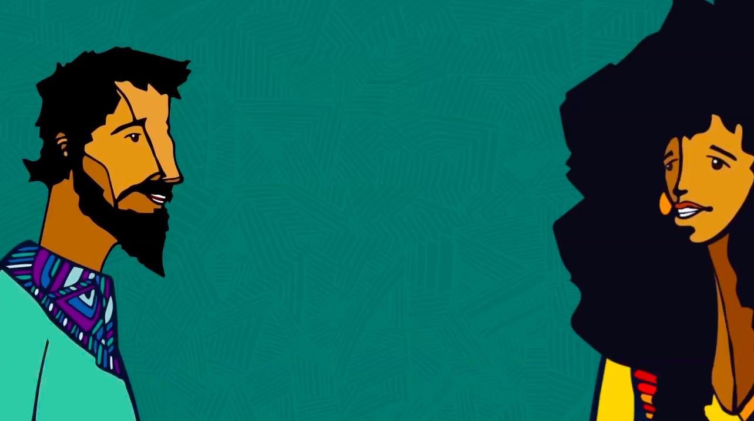
⁷ When a Samaritan woman came to draw water, Jesus said to her, “Will you give me a drink?” ⁸ (His disciples had gone into the town to buy food.)
Notes:
(Ask for a volunteer reader.)
“Jesus takes the initiative first with this stranger. Jesus likes to break the ice. As we are full of Jesus love and courage, we join Jesus in breaking the ice with anyone.”

Slide 10
⁹ The Samaritan woman said to him, “You are a Jew and I am a Samaritan woman. How can you ask me for a drink?” (For Jews do not associate with Samaritans.)
Notes:
(ask for a reader)
The woman is surprised. She lists the reasons why they should not be talking. She names the barriers he is crossing. Man, woman, Jewish, Samaritan.
“In the historical context, there were hundreds of years of animosity and even violence between Samaritans and Jews. On top of that, men and women didn’t tend to chat in public.
In today’s vernacular, she’s saying to Jesus, “Why the heck is someone like you talking to someone like me?!”

Slide 11
¹⁰ Jesus answered her, “If you knew the gift of God and who it is that asks you for a drink, you would have asked him and he would have given you living water.”
Notes:
“Instead of answering her directly, Jesus invites her into a deeper conversation. He points toward himself in intriguing ways. Jesus creates a new metaphor for himself: water-that-is-alive. Jesus talks and lives curiously. Jesus offers her a choice. Does she want to be curious and engage more deeply? Or does she prefer to just walk away from this odd stranger? (In a future training, we will learn about how to discern these pivot moments in conversations.)
She chooses curiosity. Then Jesus invites her a level deeper.

Slide 12
¹⁶ He told her, “Go, call your husband and come back.”
^{17a} “I have no husband,” she replied.
Notes:
(Ask someone to read) “Jesus gives her another choice. She could reveal something about her personal life, or she could walk away. She engages again.

Slide 13
^{17b} Jesus said to her, “You are right when you say you have no husband. ¹⁸ The fact is, you have had five husbands, and the man you now have is not your husband. What you have just said is quite true.”
(John 4, NIV)
Notes:
“Jesus honors her openness, ‘You are right.’ Because she engages, he shifts the conversation even deeper. Jesus is not afraid of steering toward a vulnerable conversation, even with a new friend. How about us?”

Slide 14
Vulnerable
How do you feel about having a vulnerable conversation?
Notes:
(click) “Let’s pause for a self-assessment. How do you feel when you are having a conversation that becomes very vulnerable, maybe even including tears?
‘Let’s vote. This exercise is called Fist to Five. On the count of three, each of us will show our hands, fist to five, Fist = I hate vulnerable conversations. 5 = Bring on messy conversations. One, Two, Three, vote.”
“Now, back to the text.”
TIP FOR THE TRAINER
If you wish, take a second and scan the room. Call out the number of fingers that seem to have the most votes. For example, “We are mostly 2’s. That means we are a little bit uncomfortable with vulnerable conversations. Thank you.”

Slide 15
¹⁹ “Sir,” the woman said, “I can see that you are a prophet. ²⁰ Our ancestors worshiped on this mountain, but you Jews claim that the place where we must worship is in Jerusalem.”
Notes:
“She engages yet again. Now she brings up a thorny topic that has divided Samaritans and Jews for centuries. Jesus does not shrink back from a tough question. How about us?”

Slide 16
Tough Questions
How do you feel when someone asks you a question you cannot answer?
?
?
?
Notes:
“Time for another self-assessment. How do you feel about someone asking you a question that you have no clue how to answer? Fist to five, fist = I hate having no answer; 5 = bring it on. Ready, vote.”
“Here is a word of encouragement. People WILL ask us things we have not considered before. Embrace it. Don’t get defensive. Try this type of 3-fold response.
Great question. I have no idea.
Thank you for asking me. God is using you in my life to help me think more deeply about these things.
I will explore this question, and get back to you next week.
If you say this, please do actually research the question and get back to them.”
“Jesus teaches her about true worshippers, which allows her to reveal her deeper search.”

Slide 17
²⁵ The woman said, “I know that Messiah” (called Christ) “is coming. When he comes, he will explain everything to us.”
²⁶ Then Jesus declared,
“I, the one speaking to you— I am he.”
Notes:
“She tells Jesus that her deeper longing is for the Messiah. Jesus honors her courage by revealing his full identity to her. This remarkable Samaritan woman is the first person in the Gospel of John to know that Jesus is the turning point of history. Watch what she does next.”

Slide 18
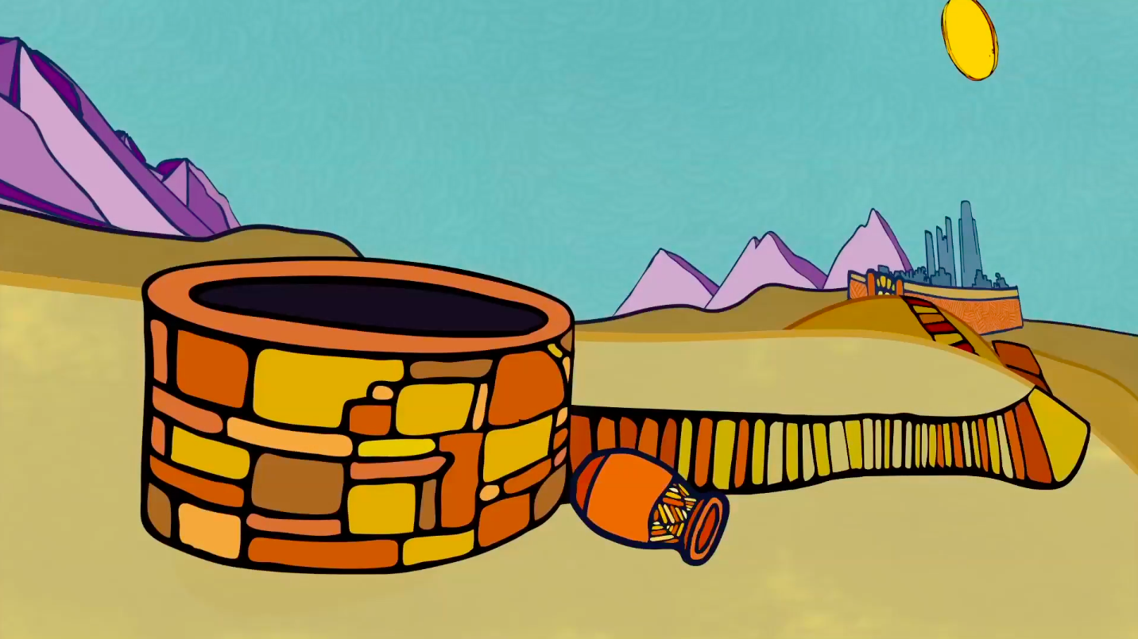
²⁸ Then the woman left her water jar and went back to the city. She said to the people, ²⁹ “Come and see a man who told me everything I have ever done! He cannot be the Messiah, can he?” ³⁰ They left the city and were on their way to him.
Notes:
“This woman has tasted Jesus’ living water. She leaves her jar behind. Her joy overflows. She shares her story with neighbors, ‘Hey guys, come check out this man who told me all I’ve ever done. Could he be the Messiah?’ After one conversation with Jesus that moved from the surface to her core desire, she becomes a faithful witness. Amazingly, her whole city comes to check out Jesus.”

Slide 19
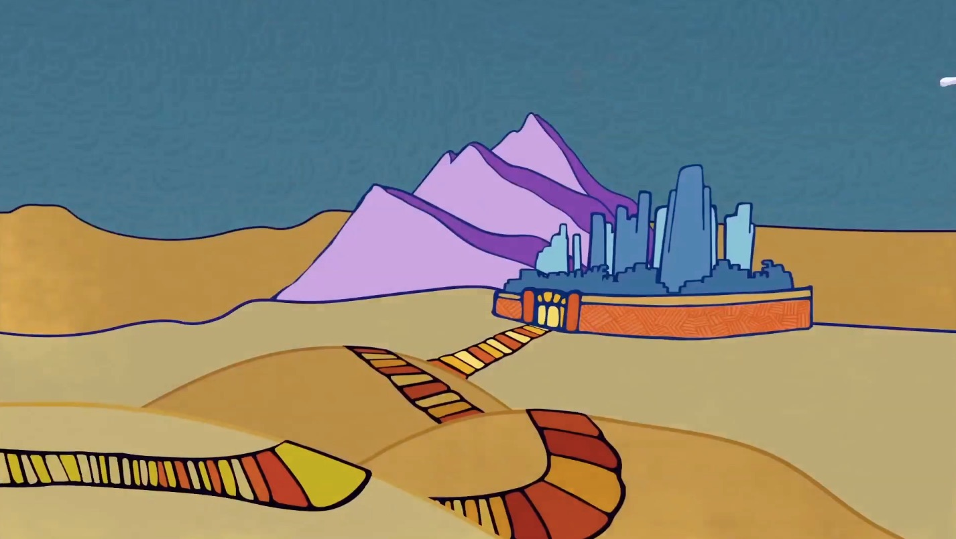
³⁹ Many Samaritans from that city believed in him because of the woman’s testimony, “He told me everything I have ever done.”
⁴⁰ So when the Samaritans came to him, they asked him to stay
with them; and he stayed there two days. ⁴¹ And many more
believed because of his word.
Notes:
“God ignites one of the most amazing revivals in all of scripture here in John 4, through one woman who encountered Jesus used her voice and told her very simple story. Thank God for her courage.
What would our community be like if everyone who has had an encounter with Jesus used their voice and told their simple story and there was a ripple effect of revival?
TIPS FOR THE TRAINER
If you will train all five sessions, you might say, “In Session 5, we will go deeper on this theme of new believers sharing their stories.”

Slide 20
Recap
Jesus initiates
Jesus stokes curiosity
Jesus deepens the conversation
Notes:
Jesus takes the first step. He starts the conversation. He crosses through all the barriers and the awkwardness. Jesus loves first.
Jesus stokes curiosity. He talks about water that is alive. Gushing springs overflow from within. He is exploring to find out where God is at work in her life. What is she thirsty for?
(click) Jesus deepens the conversation, like peeling back the layers of an onion. She follows his lead, layer by layer, until she feels safe to bring her most real self and her big question into the light.
Jesus is the good news. He is the living water, the great I AM. Because of this loving, courageous conversation, she worships in spirit and truth by verse 26. Relational evangelism has always been Jesus’ game plan.

Slide 21

Seeing where God is at work
Ask questions
Listen attentively
Interact expectantly
Notes:
“In our next trainings, we will learn three crucial habits that will help us look intently for where God is at work in our relationships.
We will learn to ask better questions, just like Jesus does.
We will learn to listen more attentively to the people around us.
We will grow in our expectancy as we embrace Jesus’ harvest mindset. We will expect God to show up in our relationships.

Slide 22
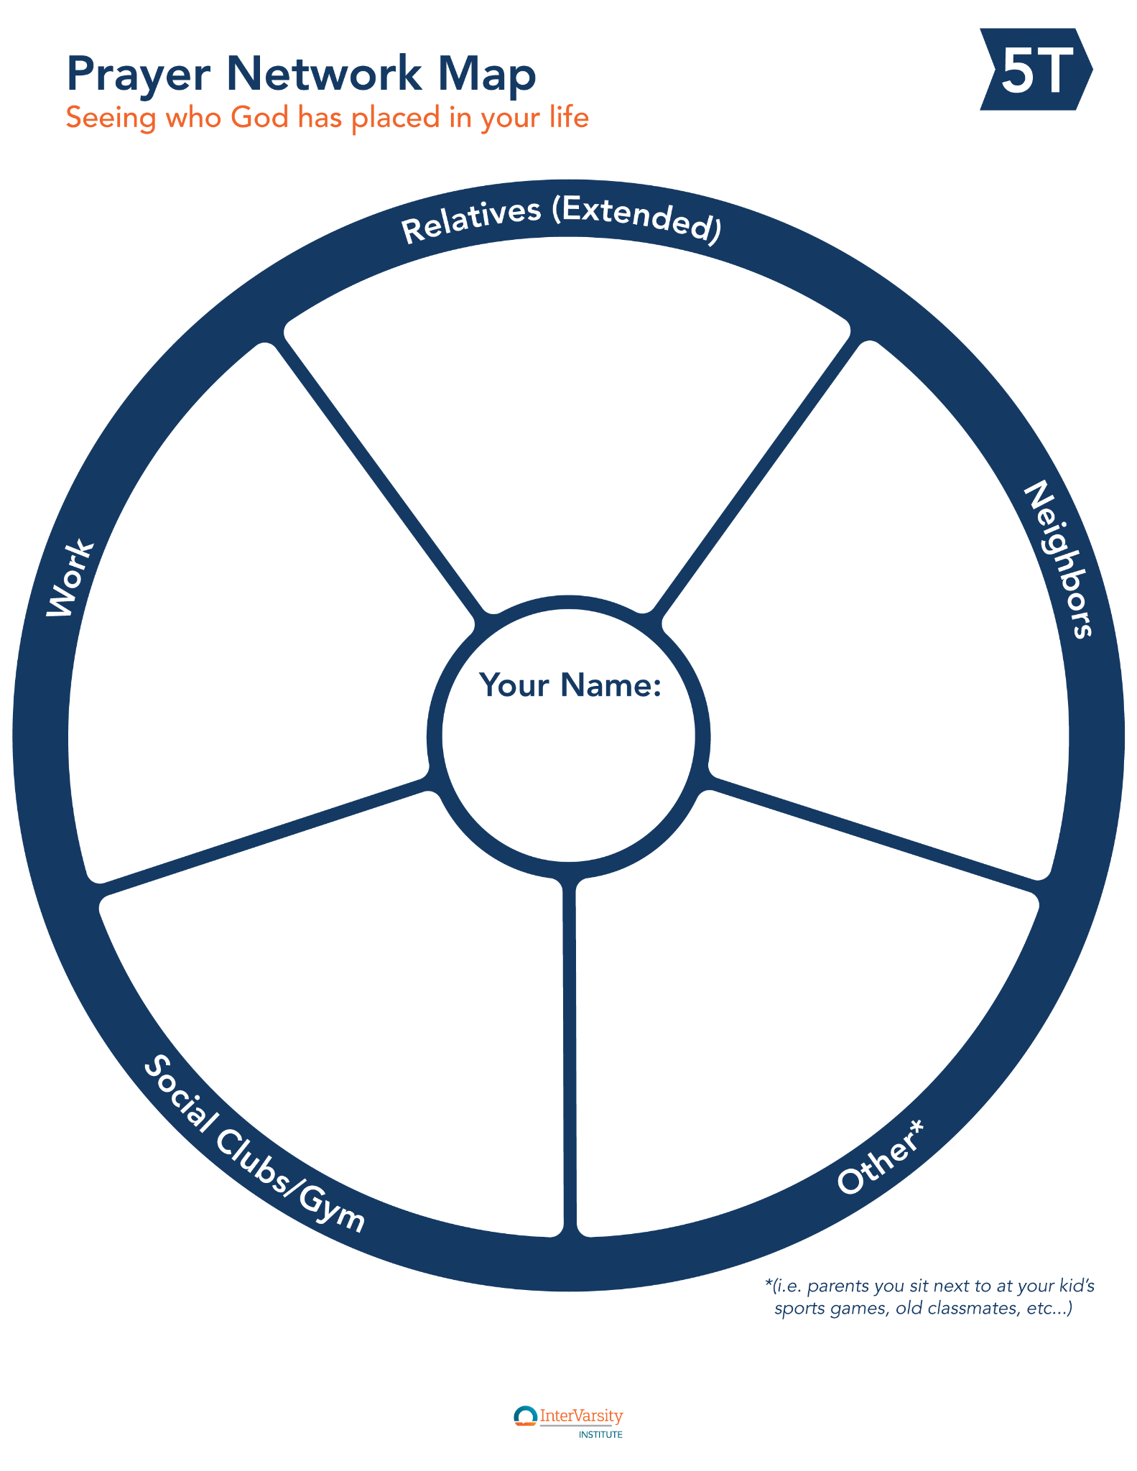
How to make the map: Link
Notes:
“Let’s shift to our relationships, and we will create prayer maps. Take this worksheet, put your name in the middle, and think about the places where you have relationships. Write down all the names you can think of. Especially those who do not attend church regularly.
work
neighborhood
extended family and relatives
gym or social club
etc. kids sports teams. favorite coffee shop, people you volunteer with, kids teachers,
“Let’s close in prayer. In 3’s, pray by name for some of the people who have come to mind.
TIPS FOR TRAINERS:
You might wish instead to create a communal prayer map on your wall.
https://nso.intervarsity.org/library/creating-communal-prayer-wall-prayer-network-map
In our tables, we want to practice John 4:35 when Jesus tells the disciples: “Lift up your eyes and see how the fields are ripe for harvesting.” This prayer map exercise helps us “lift up our eyes” of faith to see where God might be at work among our friends and acquaintances. We recommend that you return to this prayer map on a regular basis (monthly?) throughout the year and keep adding to it.
End the time by creating a prayer map. A prayer map is a type of communal network map that allows the whole group to see the non-Christian connections across the group. Use this article and follow the instructions. End with a few minutes to pray for the names listed. Lead a brief listening prayer to ask God to highlight a couple people to focus on as you grow in friendship evangelism.
A prayer map takes approximately 15 minutes to make for a group of 10 people. You can speed it up by having more people write at the same time.

Slide 23
LEADER: Father, thank You for inviting us to be a part of Your Kingdom expanding.
ALL: May Your Kingdom come.
LEADER: Forgive us for how little we have prayed for those who don’t know You.
ALL: Help us to continue steadfastly in prayer, being watchful, with thanksgiving.
LEADER: Father, as we think about specific people who don’t know You, we cry out:
ALL: Open doors for Your Word! Help us make Your Gospel clear, which is how we ought to speak.

Slide 24
LEADER: Help us walk in wisdom with those who don’t know You, making the best use of the time.
ALL: Help our speech always be gracious. Help us know how we ought to answer each person.
ALL: May the mystery of Christ be known in our neighborhoods, in our cities, and throughout the world. In the name of the Father and the Son and the Holy Spirit. Amen.

Slide 25

Next Week
Mentoring
New Believers
Invitations that
Change Lives
Asking
Good Questions
The 5 Thresholds
of Faith
God does the Work
Notes:
In our next session, we dig deeper on how the layers of the relationships go deeper. We call these the 5 Thresholds of Faith.

