Slide 1

Relational Evangelism Training
Session #2

Slide 2

Relational Evangelism Training Session #2
The 5 Thresholds of Faith
Growing in Relational Evangelism
Notes:
“Welcome to our Training on Relational Evangelism.
Today, we will learn about the 5 Thresholds of faith: trust, curious, open, seeking, following.
But first, where does this fit in the overall flow of these Trainings?”
TIPS FOR THE TRAINER
Please print out and be prepared to distribute the worksheet (when you hit slide 11). Make sure everyone has a pen. Help people fill out the 5 Thresholds Worksheet as you go through slides 11-21.

Slide 3

Our 5 Trainings
Our 5 Trainings
Mentoring
New Believers
Invitations that
Change Lives
Asking
Good Questions
The 5 Thresholds
of Faith
God does the Work
Notes:
Stacks upon our robust confidence that it is God who does the work! We are learning to think differently and pray differently, “God is already at work.”
Jesus shows us a great way to discern HOW God is at work around us: Jesus gets into conversations. As we talk, the layers of the onion slowly peel back.
The 5 Thresholds give us language for how to have these conversations, what people are ready for, and how we can walk alongside them.

Slide 4
THE 5 THRESHOLDS
From I Once Was Lost by Doug Schaupp and Don Everts (IVP)
Notes:
“These are InterVarsity’s 5 Thresholds, or 5 steps that non-Christians commonly go through on their journey toward faith. We discovered these after interviewing a multi-ethnic, diverse group of women and men. They’re recorded in a book called I Once Was Lost if you would like to check it out and go deeper. Let’s jump into this awesome adventure together.”
In this session, we will learn 3 things….
You will identify your gift and major contribution in Jesus’ harvest
You will understand these five phases that the people around you are going through right now.
You will discern a practical next step that you can take with at least one friend.

Slide 5

MARK 4:26-29
The harvest is more ripe
than we think.
Notes:
Let’s start with Jesus. He tells us that the harvest is good, the harvest is ready, and we get the honor of joining him in his adventure. This parable will help us see the world around us like Jesus does.

Slide 6
He [Jesus] also said, “This is what the kingdom of God is like.
A man scatters seed on the ground. Night and day
whether he sleeps or gets up, the seed sprouts and grows,
though he does not know how. All by itself the soil
produces grain—first the stalk, then the head, then the
full kernel in the head. As soon as the grain is ripe, he
puts the sickle to it, because the harvest has come.”
Mark 4:26-29 (NIV)
Notes:
(Ask a volunteer to read the Scripture out loud.)
“There are different phases in the harvest, which can be a bit complicated. Are we scattering seed mode, or are we harvesting? Some would like to control this complexity by reducing the harvest to just one thing, their thing. In fact, entire theology books have been written to over-simplify the harvest. Jesus wrecks our theologies. ”

Slide 7
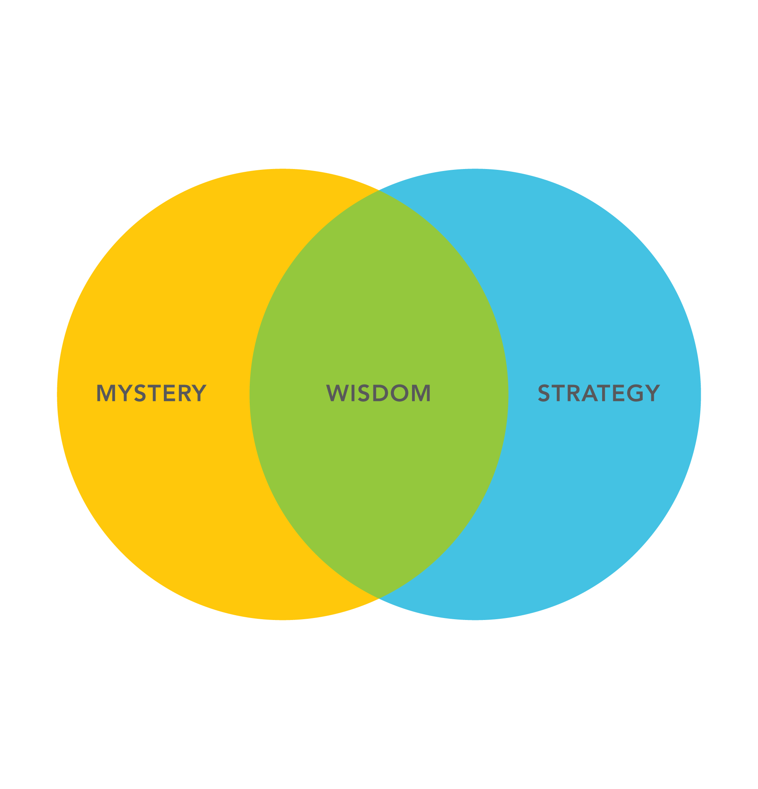


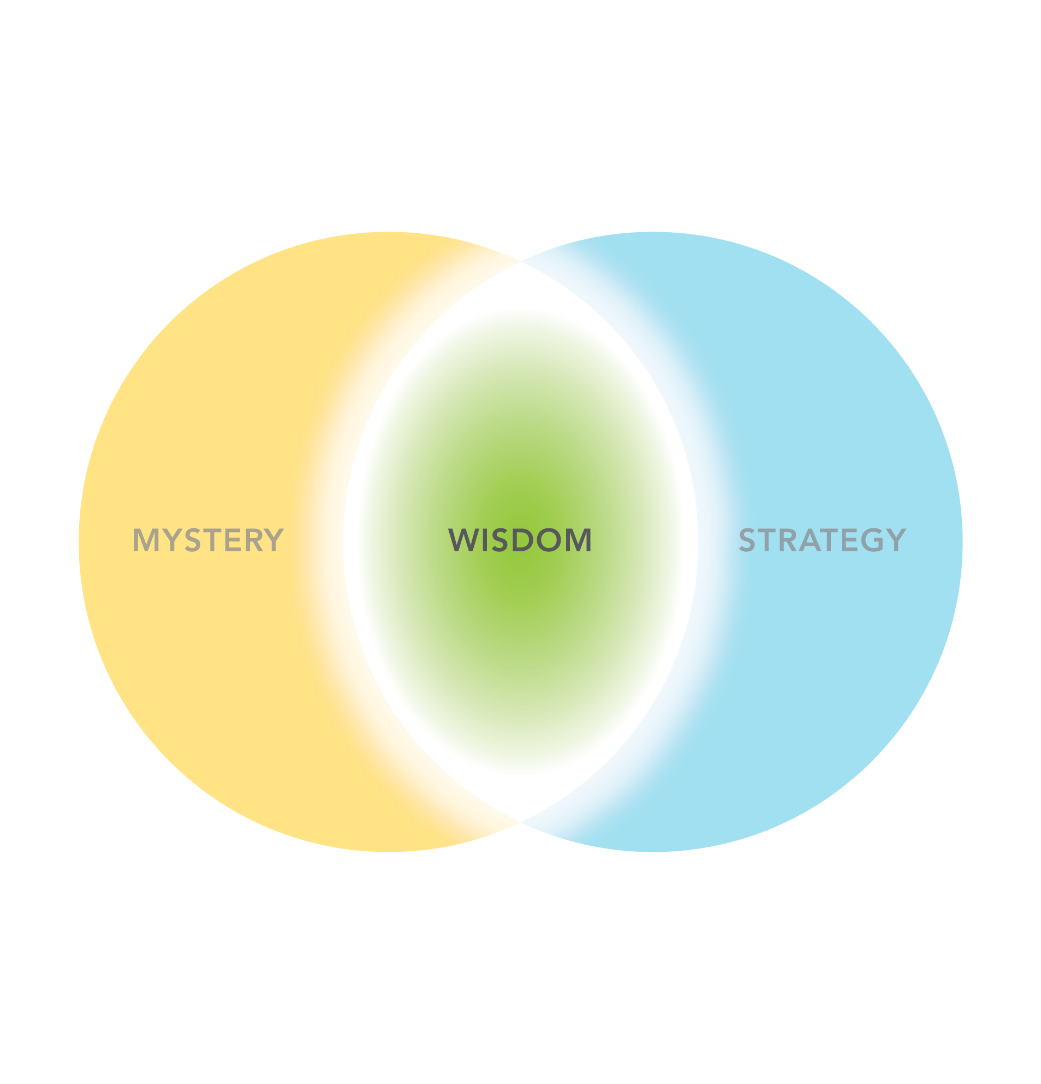
Notes:
“Jesus’ harvest is a paradox. (Click)
On the one hand, it is a mystery. The farmer has no idea which seed will sprout, and which will not. (Click)
And it is a predictable pattern. You must wait for the full head of grain before you put in the sickle. Do not harvest the baby stalk. Expect it to mature according to a pattern.
So, which is it? A mystery or a strategy? Yes, it is both. (Click)
Is it a patient process or an urgent moment? Yes, it is both. (Click)
Who is the active agent in the parable: the ground, the seed, or the farmer? Yes, all have agency.”
Wisdom is found as we live in the midst of the tensions, and avoid the temptation to be reductionistic. There are four distinct phases we want to highlight and apply.”

Slide 8
What is the farmer good at?
Throwing the Seed
Expecting New Life
Discerning the Growth
Harvesting the Crop
Notes:
“What is the farmer good at?
(Click) “Throwing the seed: He has a strong right arm and can scatter the seed effectively.”
(Click) “Expecting new Life: He understands the mystery of growth. He is hopeful and expectant that the seed will indeed sprout.”
(Click) “Discerning the growth: He does not get confused between a small stalk and the full head of grain.”
(Click) “Harvesting the crop: He is very good with the sickle when it is time. He is skilled and urgent.”

Slide 9
What are YOU good at?
Throwing the Seed:
you are good at
meeting people
Expecting New Life:
you pray for the
harvest
Discerning the Growth:
you sense where people
are at with God
Harvesting the Crop:
you help people
commit to Jesus
Notes:
“Let’s apply this to us. Pick the ONE area you are best at.
(Click) Some of us are best at throwing the seed. That means you like meeting new people and you are friendly.
(Click) Others of us are strong at intercession. You practice hopeful anticipation; you pray expecting the harvest, and you embrace the mystery.
(Click) Others of us discern the growth. Within about 5 minutes of meeting a non-Christian, we can guess their level of interest in God.
(Click) Lastly, some of you are strong at the harvest and the sickle. You help people commit to Jesus.”
[OPTIONAL: have them share with their neighbor] “Now, your turn. Share with your neighbor one strength you have.” (Turn in pairs for 30 seconds)
“Now, let’s vote. Raise your hand only once for what you are best at.
“Whose strength is meeting people? (some hands go up)
Whose strength is intercession? (some hands go up)
Whose strength is discernment? (some more hands)
Whose strength is helping people commit to Jesus? (some more hand)
“Which of these four is the most important part of the process? Yes! All four are essential and distinct. We all have a place in Jesus’ harvest. We all contribute our strengths.”
“The 5 Thresholds will help us navigate these tensions, and help us apply these phases of the harvest in practical ways.”
TIP FOR TRAINERS
You will learn quite a bit about your congregation from the number of hands raised for each of these. You will quickly see your strengths, and places for future growth and attention. Take mental note, and share with your leadership at a later date.

Slide 10
The 5 Thresholds
Notes:
Just like in the parable, the pathway toward Jesus is not one thing, it is not one phase. In fact, after interviewing hundreds of new believers, we have discerned a pattern of five phases, now called the 5 Thresholds.
You must understand the journey that non-Christians are on in order to bless them and be good friends and help them grow toward Jesus.
The 5 Thresholds helps us lovingly embody the four parts of Jesus’ harvest.
Here is a short video overview.

Slide 11

5T Overview Video
Notes:
“What was your favorite part of the video?” (Ask for a few volunteers, or have them discuss with their neighbor for 30 seconds.)
“Get out your worksheet. Feel free to jot down the most important idea from each threshold in the answer box. We will dig into each threshold, one at a time, and identify the key barrier to overcome in each one. If someone’s name comes to mind, feel free to write down their name as well.”
TIPS FOR THE TRAINER
There are five other short videos in our Threshold series. We have not included them in this training because adding 25 additional minutes of video is quite long. Watch each one ahead of time, and select one or two that you feel will be most helpful for your context.
In addition, if anyone in your church wants to grow in their understanding of the Thresholds, please give them this link.
https://evangelism.intervarsity.org/threshold-1-trust

Slide 12




Distrust
Distrust
Trust
Notes:
In the 1st Threshold, we often encounter Distrust in today’s age of skepticism. Particularly on the coasts, Distrust is often the knee-jerk reaction we get when others find out that we are Christians.
So, we become trust-builders. Instead of being offended by Distrust, we engage in intentional trust-building…by having FUN together. We invite them to do what we like to do, and we join them in doing what they like to do. This is called trust-building.
TIP FOR TRAINERS

Slide 13

Why don’t people
automatically trust Christians today?
How can we have fun together?
Notes:
Why don’t people automatically trust Christians today? In the past, the word “Christian” was a good word. Not so much today.
As the Apostle Paul wrote, there are times when the gospel is in season, and times when it is out of season. Christianity is less ‘in season’ now than it used to be. We used to expect people to trust us, but now we get to proactively build trust.
The church used to be highly respected. But because of some scandals, people unfortunately trust us less today.
What is one thing that you can do with a non-Christian friend this week to increase trust? (Optional: 1 minute in pairs to discuss.)
TIPS FOR THE TRAINER:
Be prepared to share a 30 second example of your favorite way to build trusting relationships with people.
Ask the listeners to get out a pen, “In the box, write down one way you like to build relationships.”

Slide 14



Indifferent
Indifferent
Curious
Notes:
Then in the 2nd Threshold, they tend to be Indifferent. They may trust us, they may like us, but they may be completely uninterested in our faith or our church. There is a myth that if we are a nice Christian, they will eagerly ask us questions about our faith. This is seldom true today.
Here’s the funny thing about our context. Let’s say we have a group of friends who have different beliefs, but they don’t discuss these differences. It is normal to have friends that are passionate about various things, but they are not curious about each others’ various passions (unless you happen to share that same interest.)
We live in an age of Indifference. Instead of being offended by people’s Indifference, we can help them become Curious. Soon they will ask us “Do dogs go to heaven?” Or other questions like that. Let’s build upon that, and keep asking them questions about themselves.

Slide 15

“What is your spiritual background?”
Jesus is superb at asking great questions.
Why are his followers just focused on giving the right answers?
What are a few questions you can ask?
“What does that mean for you today?”
Notes:
Jesus is the master of asking probing, intriguing questions. Jesus did not have Q&A sessions. Jesus had Q&Q sessions.* When people ask Jesus a question, he will often ask a question right back. So why are questions so effective?
People like to talk about themselves. It is a gift to draw them out and help them talk about their lives and dreams.
Curiosity is contagious. If we want them to become curious about Jesus, it is helpful for us to be curious about their spiritual lives and beliefs.
Questions help people discover their own deep yearnings and longings. Questions help people uncover their soul’s yearning for God.
Isn’t it ironic that while Jesus is so good at asking question and stoking curiosity, we Christians tend to be much more focused on the right answers.
Let’s get practical. What are a few questions you could ask? Here are two of my favorites: (click) What is your spiritual background? (click) What does that mean for you today? (Break into pairs.) What are your 2 favorite questions?
TIPS FOR THE TRAINER:
OPTIONAL: If you have time, you could break them into pairs for 1 minute and ask them to share their several favorite spiritual questions. At the end, have them pick their favorite, write it down in the box on the worksheet, and try to use it this week.
*See Tom Hughes’ Curious

Slide 16



Closed to Change
Closed to
Change
Open to
Change
Notes:
“In the 3rd Threshold, they may begin to ask us theoretical or academic questions about the meaning of life. But they are using their heads, not their hearts. Like this safe here, their heart is Closed to Change.
By the end of the 3rd Threshold, they actually become Open. They open their hearts, they open their personal lives to us. They may not be open to Jesus yet, but they are real with us.
How do we help them move from Closed-to-Change to Open-to-Change?
2 Cor 12:9 reminds us that God’s power is made perfect in our weakness. When we talk candidly about our weaknesses, and how God meets us in our brokenness, God gets the glory. It is unpleasant for us, but true.
One of our best evangelism options is to be vulnerable ourselves. Let's open our hearts to them, share our struggles, and tell them how God is real today in our lives. Once we are transparent, we help them reciprocate and open their hearts toward us. Your authenticity and transparency is often the door toward Jesus that they walk through in this Threshold.
TIPS FOR TRAINERS
If you have the time, be prepared to share a 1 minute story of how God worked through a weakness or struggle in your personal life to glorify himself.

Slide 17
Anger
Anxiety
Depression
Numbness
Fear
How can you be more vulnerable in your relationships?
Try this prayer exercise.
Notes:
“Let’s practice. Each of us is going to share a practical area of personal need, first with Jesus and then with your friend.
Read over this list, and pick one, only one you felt this week: Anger, Anxiety, Depression, Numbness, or Fear. Let’s take 10 seconds to pray. Holy Spirit, I have been feeling ….. this week. I invite you to touch that area of my life with your love right now.” (Pause for 5 seconds). Please turn to your neighbor. Which emotion did you feel? (give them 30 seconds to share)
“Please write it down on your paper. Later today, share with anyone, “I did this prayer exercise at church today. I have been feeling ….. this week. I invited God to touch that area of my life. I felt …..”
TIPS FOR THE TRAINER:
Please do this exercise ahead of time. Be prepared to share your negative feeling from the week.
Sometimes, people will look at this list and say, “None of the above” or “all of them.” Please insist that for this exercise they have to push themselves to just focus on one. Praying about one specific feeling of weakness is far more powerful than just vaguely bringing “all my problems” to Jesus in prayer. Specificity makes it real, and gives us something practical to share.

Slide 18



Wandering
Wandering
Seeking
Notes:
In the 4th Threshold, they are Wandering. They do not know how to seek Jesus. No one has taught them how to be a seeker. Without our help, they tend to explore everything. They might read books about Buddha, Krishna, and Jesus. Their wandering and confusion and inconsistency drives us nuts. “Why are they wasting their time looking at three things at the same time?!”
They might be circling in the maze of life because no one has ever taught them to seek.
How can we be good friends to people who are wandering?
It can be tempting to become irritated in this threshold. Pray for wisdom to see what is holding your friend back, and wisdom for yourself to re-engage in a fresh way.
Look deeper into their questions and yearnings. Use eyes of discernment to unearth what they are really looking for.
For example, what might be behind this question: “If God is good, why is there suffering in the world?” You might begin to answer from the head, and talk about predestination. Or you could infer that they probably have experienced suffering in their personal life, and clarify their question, “Do you think Jesus could heal your pain?”
By the end of the 4th Threshold, when they actually become Seekers of Jesus, we get a front row seat into God’s transforming work. This is one of the most beautiful mysteries in life. How can we compassionately help move them from Wandering to Seeking? By clarifying their journey. We have the honor of coming alongside our friends, and helping them discover what they need to know about Jesus.

Slide 19

Many seekers seldom take steps forward
because they are wandering.
”If Jesus were trustworthy, what would you ask him?”
“What question will help you discern if Jesus is trustworthy?”
Notes:
“Many seekers seldom take steps forward because they are wandering. We can ask them a really helpful question, like this: ‘If you were talking with Jesus right now, what is the one question you would ask in order to figure out if he is trustworthy with your life?’ Please get your phone and take a photo. Or write it down on your page. Let’s memorize this question and use it. Think of a friend you could ask this to.” (You might invite them to turn to their neighbor and discuss, “What is your favorite part of this question?”)

Slide 20



Undecided
Undecided
Follower
of Jesus
Notes:
“In the 5th Threshold, sometimes people pause and remain undecided. They may feel paralyzed at this point of decision-making about Jesus. Something is holding them back. With eyes of faith and compassion, let’s look deeply into their lives and see what it going on. They may not know what following Jesus even means. Let’s help them understand what it means to be a Christian, and consider following Jesus with the rest of their lives.
So, what is the best way to help them become a follower of Jesus? We invite them!

Slide 21

Jesus loves to invite
people to become his followers.
We get to offer the same invitation!
How can you grow as an inviter?
Notes:
“Jesus loves to invite people to become his followers. We get to offer the same invitation to confess faith!
Here’s one that you can use:
One way we like to do this is to tell them ‘Everybody has a crucial decision to make. Who will be at the center of your life? Do you want you yourself to be the center, or do you want to let Jesus become the center of your life? I think you and I would be wise to make Jesus the center of our lives. What would it take for you to follow Jesus, and allow Jesus to become the center of your life?’”
How can you grow as an inviter?” (Optional: pairs to discuss for 1 minute.)
TIP FOR THE TRAINER
If you wish to show them a real example of how we can offer a clear and compelling invitation to confess faith in Jesus, see Training #4 for our 3 minute Refresh short film (bonus section, slide 35).

Slide 22
The 5 Thresholds
Notes:
How they fit together

Slide 23
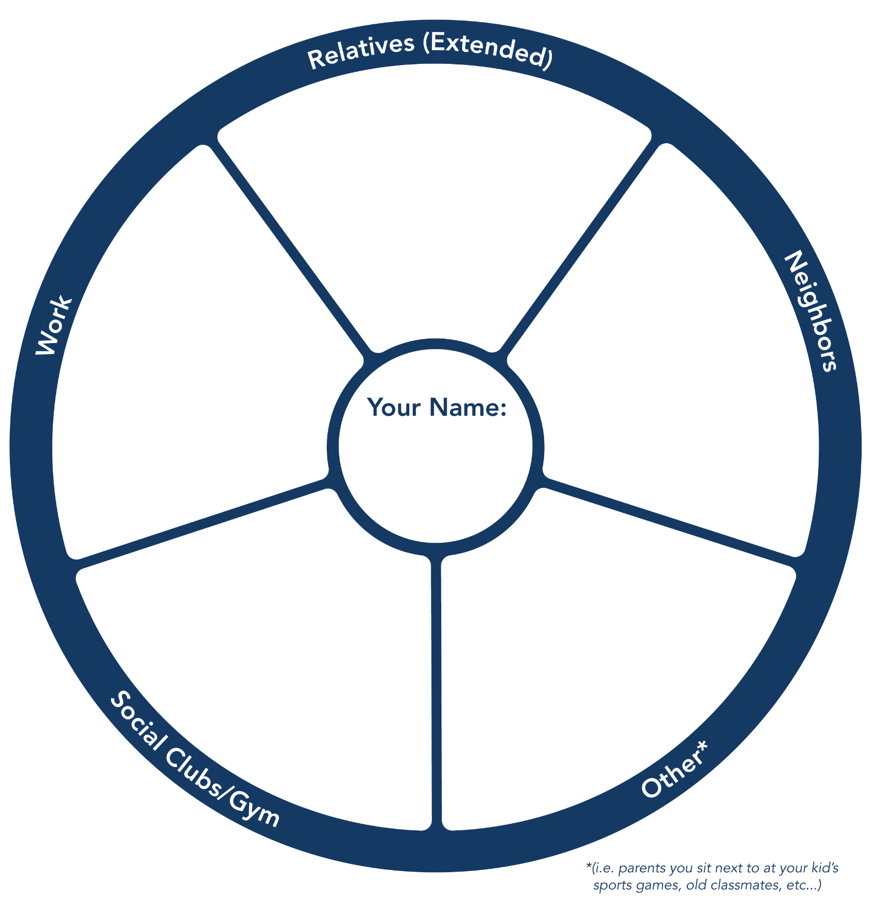
Guess where your friends are at
Notes:
“Let’s apply the Thresholds to our relationships. Please fill out this Prayer Worksheet and practice guessing where two of your friends might be in the Thresholds”.
“When you are done putting two names in the boxes, please raise your hand.” (Wait for half the room has raised their hand.) “Great. Turn to your neighbor. Describe one or two of these relationships. And pray for them by name.” (give them two minutes).
TIPS FOR TRAINERS
Before this training, print out this “2+ Prayer Worksheet” for each participant. Read it over a few times so that you are clear about how to fill it out. Then hand it out at this point in the training. If you already did a prayer map exercise, tell them, “We already created your prayer map. Jot down the names of six people who know who do not go to church regularly. Then focus your intercession on just two, and write their names in the two boxes.”
Some may struggle to fill this out. Do not wait for everyone to finish. You can help them privately later brainstorm how to grow their relationships.
The 2+ doc is at this link: https://evangelism.intervarsity.org/sites/evangelism/files/2%2BPrayerISM-1.21fillable-B.pdf

Slide 24
Notes:
“Let’s recap: today we have been learning to see differently. These are not merely names on a piece of paper. Your networks are an important part of Jesus’ emerging harvest right in front of us. May Jesus give us eyes to discern the growth and courage to take some risks of love.”

Slide 25
Our 5 Trainings
Mentoring
New Believers
Invitations that
Change Lives
Asking
Good Questions
The 5 Thresholds
of Faith
God does the Work

