Slide 1

Relational Evangelism Training
Session #3

Slide 2

The 5 Thresholds
From I Once Was Lost by Doug Schaupp and Don Everts (IVP)
Notes:
Original notes: “These are InterVarsity’s 5 Thresholds, or 5 steps that non-Christians commonly go through on their journey toward faith. We discovered these after interviewing a multi-ethnic, diverse group of women and men. They’re recorded in a book called I Once Was Lost if you would like to check it out and go deeper. Let’s jump into this awesome adventure together.”
In this session, we will learn:
How to have better relationships with non-Christians.
How to overcome the trap of indifference and help your friends become curious
How to ask connecting and deepening questions and become more intriguing in your relational evangelism

Slide 3
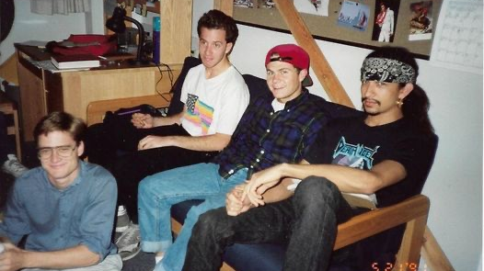
Notes:
TIPS FOR TRAINERS
Please delete Doug’s 2 slides of his personal story and instead insert a personal story of your own.
It could be a story of how you are personally using the 5 Thresholds in one of your current relationships
It could be a story of an evangelism experience you had and what that taught you about one of more of the thresholds.

Slide 4
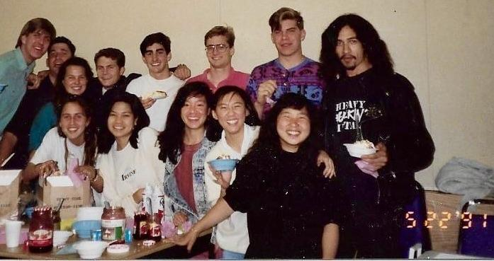
Notes:
What happened in that conversion community?
Half of these beautiful people point to that year as their conversion year, when they started following Jesus.
Many of them became student leaders the next year or two, and offered Jesus to many others.
Staff, one pastor, one missionary, one national director, many world changers
the community is the hero of this story.

Slide 5

Relational Evangelism Training Session #3
Asking
Good Questions
The lost art of spiritual conversations
Notes:
“Welcome to our Training on Asking Good Questions. We are going to work on the lost art of stoking curiosity.”
“Good questions are surprisingly helpful in spiritual conversations. And they are just as important in marriages, friendships, and at work.”

Slide 6

Our 5 Trainings
Mentoring
New Believers
Invitations that
Change Lives
Asking
Good Questions
The 5 Thresholds
of Faith
God does the Work
Notes:
We are building upon the foundation that God does the work. And we are going deeper with the 5 Thresholds.

Slide 7

Growing in the 2nd Threshold
Myth: If we are nice Christians, our friends will ask us questions about our faith.
Notes:
There is a hidden trap within each threshold where non-Christians get stuck:
In the first threshold, the trap is distrust.
In the second threshold, the trap is indifference.
In the third threshold, the trap is closed to change.
In the fourth threshold, the trap is wandering.
In the fifth threshold, the trap is ambivalence.
It is helpful for us to anticipate these hidden barriers. Let’s be prepared to help our friends grow through them. The trap in the 2nd Threshold is “indifference.” One of our best remedies for indifference is asking questions. By the way, asking intentional questions is helpful in every part of the journey.
(click) Here is a common myth: if we are just nice Christian people, our friends will automatically ask us about our faith. This is seldom true. Being nice is not very intriguing. This training will help us overcome this myth.
Let’s learn from Jesus.

Slide 8
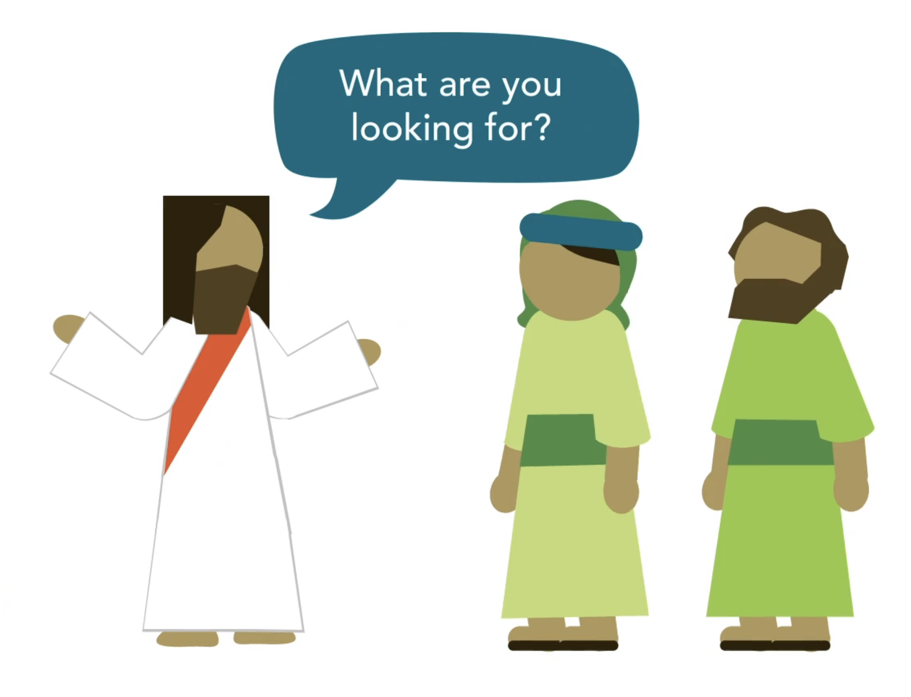
Jesus Stokes Curiosity
What are you looking for?
Jesus wants people to think for themselves.
Notes:
“Jesus is an expert at relational evangelism. In fact, he came up with the idea. One of Jesus’ favorite “evangelistic techniques” is his superb question-asking. All over the gospels, he drops intriguing or outrageous questions upon his listeners. For example, in John 3:10, Jesus asks a sarcastic question to try and provoke curiosity within Nicodemus. Our friend, Nicodemus, then reappears at the end of John, but this time he has the courage to publicly align himself with Jesus, no longer only seeking Jesus out at night time (John 19:39). Jesus’ unusual conversational evangelism style had profound impact upon Nicodemus. Likewise, we are invited to imitate Jesus and become much better question askers. Check out some of Jesus’ greatest hits.”

Slide 9
What do you want?
What do you want me to do for you?
Do you love me?
Why are you bothering this woman?
What is your name?
I said nothing in secret. Why do you question me?
Who is it you want?
But if I spoke the truth, why did you strike me?
What do you think?
Who do you say that I am?
Where are they? Has no one condemned you?
Why are you so afraid?
How do you read?
Is that your own idea?
Do you believe that I am able to do this?
What is that to you?
Do you want to be well?
Who proved neighbor?
How many loaves do you have?
Does this offend you?
What are you discussing together as you walk along?
Notes:
(Click once) “Check out all the great questions that Jesus asks, and this is just the start.
Some of Jesus’ questions are gentle. “He asks Bartimaeus, ‘What do you want me to do for you?’ (Mark 10:51)
And some are confrontational. He says to the guards, “If I spoke the truth, why did you strike me?” (John 18:23)
Growing in relational evangelism does not mean being a pushover. We will learn about both types of questions.
How do you feel about asking brave questions like Jesus?

Slide 10


2 Types of Questions
CONNECTING questions help people to open up and share honestly.
DEEPENING questions invite the conversation to go deeper.
Notes:
“There are generally two categories of questions: connecting and deepening .We will learn how to use both gears in real conversations, and you will learn that you have a choice between connecting and deepening. But first, let’s define these two gears.
Connecting questions help people to open up and share honestly.
Deepening questions invite the conversation to go deeper.

Slide 11


CONNECTING Questions
I can relate…want to tell me more?
That sounds painful, I’m so sorry. What happened next?
Notes:
“Connecting questions allow us to learn more about our friends, their spiritual experiences, their hopes and their fears.
Connecting questions follow the momentum of the conversation and encourage a person to share their story. Connecting Questions are focused on the person and their experience.
Connecting questions build rapport and trust with the person, which are the building blocks of further conversations.
Here are 3 examples (ask a volunteer to read the screen). Which is your favorite?”

Slide 12


DEEPENING Questions
Are you satisfied with that part of your life?
What is your impression of Jesus?
Notes:
“There is a saying in the United States: ‘Polite people do not talk about politics, religion, or money.’ In contrast, Jesus talks about all three of these important topics, all the time. Similarly, we will learn to ask deepening questions that help break the ice and transition conversations to spiritual topics. This can be smooth or abrupt, depending on your personality and your context. Here are two examples of deepening questions. (Ask a volunteer to read the slide.). Which do you like best?”
TIPS FOR TRAINERS
You might wish to modify these to sound more conversational. Such as, “How’s that working for you?” Or “What do you think of Jesus doing that?”

Slide 13

DEEPENING questions
can quickly shift the conversation.
Notes:
“Conversations are like the layers of an onion. deepening questions help us pivot from superficial to a deeper layer of more meaningful conversations. Good spiritual conversations help all of us explore our deeper yearnings. God has given everyone a soul, and the purpose of our soul is to yearn for God. We fill our souls with all kinds of cheap substitutes instead of filling our soul with our Creator. Deepening questions help our friends tap into the yearnings of their soul and their deeper desires. This is love.
It is fantastic when our non-Christian friend says to us after a 30 minute spiritual conversation, ‘You ask such good questions. I feel like I am getting to know myself better. Thank you for this very helpful conversation.’”

Slide 14

Let’s Practice

Slide 15

(You asked a friend about their spiritual background.)
“I grew up going to church on Christmas and Easter.”
CONNECTING or DEEPENING?
(Click the response bubble to see the outcome.)
“How about today…
do you consider yourself a
spiritual person now?”
“Don’t you hate it that Christians
are such hypocrites?”
Notes:
“Please vote. Do you think you should ask a connecting question? Raise your hand. Or do you prefer deepening?”
(On your computer, hover your cursor over the groups’ preferred answer, and click the specific speech bubble to take you to the outcome. Practice this ahead of time, so you are comfortable with this functionality.)
TIP FOR THE TRAINERS
We suggest making this interactive. Read the comment from your friend in blue. Have your group vote on which response they would give, “connecting” or “deepening”?

Slide 16

“Don’t you hate it that Christians
are such hypocrites?”
“Um, I’m don’t really know what you mean…..”
TRY AGAIN! This person doesn’t seem jaded by church. Christian hypocrisy is a great way to talk to someone who has been hurt or offended. But it’s too much if they have a positive or neutral experience of church..
TRY AGAIN
Notes:
TIPS
Read the deepening response in a slightly snarky tone.
Read her reply as an awkward moment that ends the conversation.

Slide 17

“How about today…
do you consider yourself a
spiritual person now?”
“Yeah. I think of myself as pretty spiritual.”
CORRECT! People often identify as spiritual rather than religious. They feel relatively positive about church. DEEPENING questions would be too much.
GO BACK
NEXT PERSON

Slide 18

You see a first-time guest in your small group. After introducing yourself and asking a few intro questions you ask…
“What are you looking for in a small group?”
Let’s see what his response is….

Slide 19

They laugh at your question…
“I’m only here for the food. I’m an open-minded person. I wouldn’t waste my time.”
CONNECTING or DEEPENING?
(Click the response bubble to see the outcome.)
“Tell me more of your story.
Did you go to church growing up?”
“You are perfect for our group!
We need someone to ask the real questions. Have you ever formed an adult opinion about Jesus?”

Slide 20

“Tell me more of your story.
Did you go to church growing up?”
“I can’t stand organized religion…
I saw this TikTok video about how the Pope is actually a secret agent working for aliens….”
TRY AGAIN! He has made a snap judgement about you.
You need to be more intriguing. ‘Church’ lost his interest.
TRY AGAIN

Slide 21

“You are perfect for our group!
We need someone to ask the real questions. Have you ever formed an adult opinion about Jesus?”
“Wow, I never thought about that before. Tell me more.”
NAILED IT! He did not expect to hear that. You intrigued him. He has not formed an adult opinion about Jesus.
GO BACK
NEXT PERSON

Slide 22

This is Mehmet. You are curious about which Threshold he might be in. A group of international visitors have been coming weekly to your English Language Bible discussions to practice their English with you.
You want to ask questions to see how your international friend is seeking Jesus…
CONNECTING or DEEPENING?
(Click the response bubble to see the outcome.)
“Would you like to compare the teachings in the Bible and the Quran?”
“How has learning about Jesus challenged your personal values and relationships?”

Slide 23

“Would you like to compare the teachings in the Bible to the Quran together?”
“I am not sure about that. I’m afraid that my head will explode with too much information right now. ”
TRY AGAIN! We want to help people fall in love with Jesus in the Gospels. Sometimes our friends want to compare religions. If they ask, run with it. Otherwise, we help them explore Jesus in the Gospels.
TRY AGAIN

Slide 24

“How has learning about Jesus challenged your personal values and relationships?”
“I never realized how much my values align with what Jesus is saying. Maybe I will learn more!”
NICE! This is the first time that he is realizing that Jesus has been challenging his personal values. You are making him think. Well done.

Slide 25
NEXT LEVEL
Create Your Own Questions

Slide 26
Group Brainstorm:
1. Create a profile of a non-Christian
2. Brainstorm questions to ask them
Notes:
“We’re going to have a fun brainstorm and get into your world. Ready?”
TIPS FOR TRAINERS:
In this exercise, we are creating an anonymous persona. This is an effective technique to make the training more real and useful. If your folks are unable to brainstorm a persona, be prepared to give them one of your own.

Slide 27
Create a Realistic Profile of a Non-Christian
1. Start with a person you know.
2. Create a nickname.
3. Spiritual background?
4. Funny hobby?
Notes:
On a piece of paper, have the table group create a profile of one of your non-Christian friends (keep it anonymous).
1. What’s their name or nickname?
2. What’s their major?
3. What’s their spiritual background?
4. What’s their funny hobby?
TIPS FOR TRAINERS:
In this exercise, we are creating an anonymous persona. This is an effective technique to make the training more real and useful. If your folks are unable to brainstorm a persona, be prepared to give them one of your own.

Slide 28
Brainstorm CONNECTING and DEEPENING Questions
1. Brainstorm ten possible questions
2. Categorize them by CONNECTING or DEEPENING
3. Vote for your favorite CONNECTING and DEEPENING questions
Notes:
”Try to come up with three connecting questions and three deepening questions that you might ask this person.”
TIP FOR TRAINER:
You are trying to grow their empathy and compassion for non-Christians. You are also trying to help them become more intentional in asking good questions. Feel free to take a few minutes to debrief this exercise. “What are you learning from this brainstorm? How does this help you grow as a good question asker? What is one way you can apply this tomorrow?”

Slide 29

Pairing your CONNECTING and DEEPENING questions
Notes:
“We have found that pairing a deepening question WITH a connecting question is a very helpful way to move a conversation through the layers of the onion. It does not matter which comes first and which second.”
“By putting two questions together, we keep the conversation going, talking more naturally.”

Slide 30
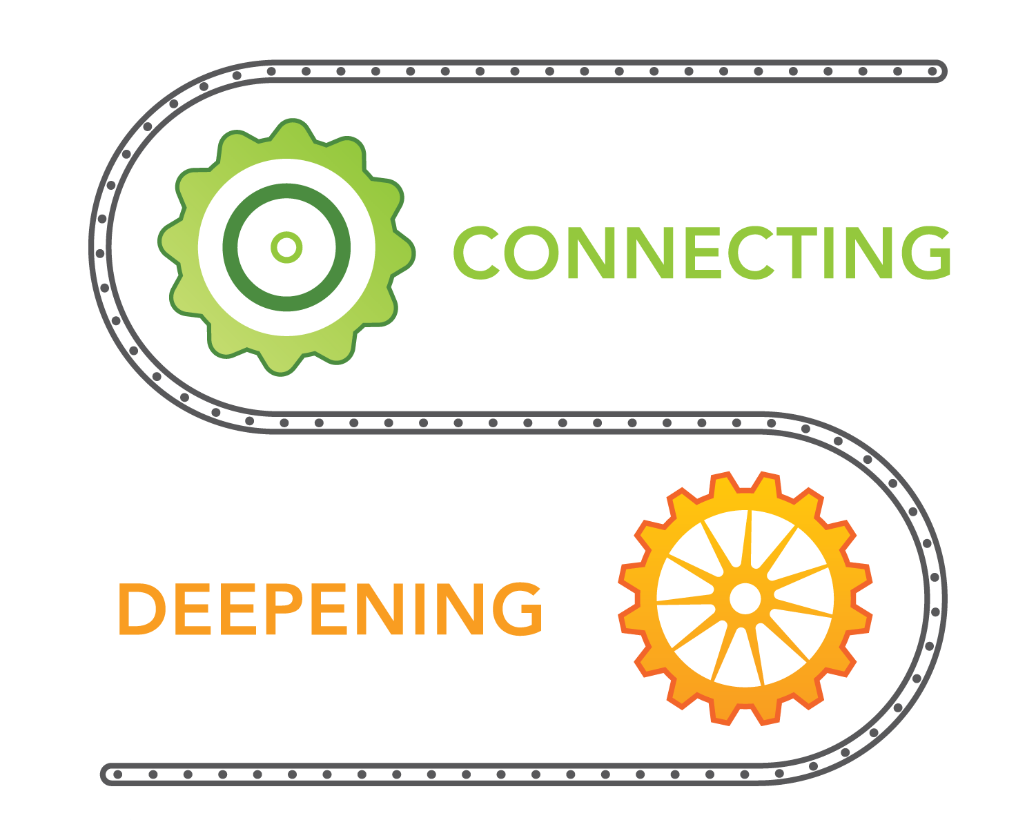
Example of a pairing
What’s your spiritual background?
What does that mean for you today?
Notes:
Ask for a volunteer to read the two questions. “We think that asking about spiritual background might be surprising, so we call it deepening. ’What does that mean for you today’ sounds like connecting.”
“Check out our questions worksheet. Circle your favorite two and get ready to use them this week. Turn to your neighbor and brainstorm how you want to become a better question asker this week.”
“Any questions?”

Slide 31

Think about your friends
Write down the names of 2 non-Christians in your life.
Text them now for coffee.
Ask them your two questions.
Notes:
“The point of this training is to become better friends. As we grow in question asking, we will help them explore their deeper desires and yearnings. We will also grow our affection and curiosity about them. People are fascinating, and questions help us become more captivated by God’s work in people.”
Asking good questions is a lifelong important skill for all kinds of friendships.
Now we will think about our non-Christian friends. Write down the name of two. Pray in pairs for your two. Please take a photo and text it to me so I can pray for your friends as well. Next week we will ask you how this went….”
TIP FOR TRAINER:
You might ask them to pair up as prayer partners for the week. Have them text each other right before they have this conversation and then again afterward.

Slide 32
RECAP:
Growing in the 2nd Threshold
Myth: If we are nice Christians, our friends will ask us questions about our faith.
Notes:
“Today we have worked on stoking curiosity using connecting and deepening questions. The point is to grow in love and friendship. Please have fun with it.”

