Slide 1

Relational Evangelism Training
Session #4

Slide 2


Invitations that Change Lives
Helping people move through the 5 Thresholds of Faith
Relational Evangelism Training Session #4
Notes:
“Welcome to our series on Relational Evangelism. What has been your favorite part thus far? What has been memorable or helpful?”
“The point of this training is this woman with the yellow blazer. She joined us for our pizza party. (click) But she doesn’t know what’s going on. SHE FEELS LOST. Today, we will learn how to offer her invitations that might change her life.”
TIPS FOR THE TRAINER
The point of this training series is to help equip STUDENTS to grow as faithful witnesses and better friends to non-Christians. When STUDENTS tell you stories about how they took risks and have been growing as Jesus’ witnesses, please celebrate each baby step.
Also, be prepared to tell a 1 minute personal story about how you have grown through this process of training on relational evangelism.
If this is your first training, please skip the entire first line.

Slide 3


Helping our Friends as they Move through the Thresholds
Myth:
“We do not need to invite people as they move through the Thresholds. They will grow when they are ready.”
Reality:
People get stuck, and need help moving to the next threshold.
Notes:
“In another Training, we learned about the 5 Thresholds, which are the 5 steps most people wander through on their way toward faith in Jesus. Trust, Curious, Open, Seeking, Following. (click) But very few people journey through the 5 Thresholds without any help from others. They often get stuck. We have the honor of joining Jesus in offering compelling invitations which God will use to help them take next steps!”
“Sadly, they’re not the only ones who get stuck. We get stuck too.” (click)

Slide 4

Common Barriers to Offering Compelling Invitations
Wrong impact. It might be manipulative or weird.
Wrong timing. I will only do this if the Holy Spirit moves.
Wrong words. I don’t want to be confusing.
Wrong friends. I don’t want to invite the wrong
people to our event.
Wrong inviter. People always say “no” to me.
Notes:
“There are various barriers we face as we try to offer loving invitations.” (Click five times. Read each sentence as they fly in.)
“Ok, now pick one barrier that you can relate to.” (Read them again, one at a time.) After reading each one, “Who relates to this one?” (vote by raising a hand)
“Now, let’s learn from Jesus.”
TIPS FOR THE TRAINER
If you have time, ask them to discuss these barriers for two minutes with their neighbor. Also, have a 30 second personal story ready to share about how God used an invitation to change your life. “I remember when Bob invited me to…That had a profound positive impact on me….Thank God for Bob.”

Slide 5
John 1
Relational
³⁷ When the two disciples heard him (John) say this, they followed Jesus.
³⁸ Turning around, Jesus saw them following and asked, “What do you want?” They said, “Rabbi” (which means ‘Teacher’), “where are you staying?”
Generous
³⁹ “Come,” he replied, “and you will see.” So they went and saw where he was staying, and they spent that day with him. It was about four in the afternoon.
Experiential
Notes:
“Jesus is an expert at compelling invitations. Here is a great example from John 1. We pick up the story in verse 37. John the Baptist has just told his disciples that Jesus the is the Lamb of God. (read verse 37)
Two of John’s disciples are now ready to follow Jesus. Jesus’ response to them is unexpected. (click) (read verse 38)
Jesus asks what they want. They wonder where he is staying. Instead of telling them the address of the house in which he is staying, he gives them an attractive invitation. (click) (read verse 39)
His first invitation to these soon-to-be disciples is: (click once, they will slowly fly in on their own as you speak)
1. relational
2. generous
3. experiential
He invites them into relationship with himself. He is generous with his time. “Spend the day with me.” Jesus wants them to experience first-hand what he is like. ‘Come, see for yourselves.’ This is an invitation to explore.
Jesus does not begin by inviting these would-be disciples to his seminary class.
Something beautiful happens next.”

Slide 6
John 1
Relational: “Come with me.”
⁴³ The next day Jesus decided to leave for Galilee. Finding Philip, he said to him, “Follow me.”
⁴⁴ Philip, like Andrew and Peter, was from the town of Bethsaida. ⁴⁵ Philip found Nathanael and told him, “We have found the one Moses wrote about in the Law, and about whom the prophets also wrote—Jesus of Nazareth, the son of Joseph.”
Generous: “Let’s spend time.”
Experiential: “See for yourself.”
⁴⁶ “Nazareth! Can anything good come from there?” Nathanael asked.“Come and see,” said Philip.
Notes:
“Four verses later, Jesus invites Philip into relationship with him. (read verse 43)
“It is natural when we have a powerful encounter with Jesus to then tell our friends and invite them to experience the same goodness of God. This is what Philip does. He tells Nathanael about Jesus. (click) (read verses 44-45)
Nathanael is skeptical. (click) (read verse 46)
Philip does not respond defensively to this negative comment. Philip does not argue. He does not try to sell Nathaniel on Jesus. Rather, he offers the same type of attractive ‘come and see’ invitation that Jesus offered v. 39.
Philips’ invitation mirrors Jesus’. It is: (click once, they will slowly fly in on their own as you speak)
relational. “Come with me”
generous. “Let’s spend time exploring Jesus together.”
experiential. I don’t need to convince you of who Jesus is. You will get convinced by experiencing Jesus for yourself. Philip is not anxious about Nathanael’s initial pushback.
Philip is becoming more like Jesus as he imitates Jesus. The same is true for us. As we courageously and lovingly offer these ‘come and see’ invitations, the Holy Spirit will shape us more into the image of Christ.”

Slide 7

Boring versus Compelling Invitations
zZz…
Notes:
“But first, we have to address ineffective invitations. Who here wants to be boring? No one!”

Slide 8
Learning from a BORING Invitation
Boring Invitations are:
Awkward
Churchy
Vague
Example #1:
“I’m starting a BIBLE STUDY because
I want to help people seek the Lord. We want to create a safe place for Christians to gather amidst the increasingly hostile secular society. We want a place for mature Christians to grow, not just baby Christians. We need a diet of meat,
not milk.” _{(1 Cor 3:2)}
Notes:
“Sometimes our invitations are vague or filled with Christian lingo. Let’s look at this “boring” sample invitation. May I please have a volunteer to read this example outloud?”
“Now, where do you notice too much ‘Christianese’ in this example?”

Slide 9
Learning from a COMPELLING Invitation
Compelling Invitations are:
Personal
Relevant
Practical
Example #2:
A few years ago, I had a lot of doubts. My friends created a safe place where I could explore faith at my own speed. Turns out, Jesus has some great ideas for helping us grow in very practical ways. Are you free next Tuesday to discuss Jesus’ teachings and try them out? If you feel more comfortable bringing a friend, the more the merrier!
Notes:
“In contrast, compelling invitations are: Personal, Relevant, Practical
Personal to your life means sharing in 1 sentence why this matters to you.
When we use plain language to explain what our event is, we are being Relevant. There needs to be a clear “what” so that they know what you are talking about.
Practical means telling them when and where, with a direct ask. Don’t be vague at the end.
In a moment, we are going to dissect the parts of this invitation. May I have a volunteer to read it for us? (Ask someone to read.) “What is your favorite part of this invitation?”

Slide 10
Compelling Invitations are:
Personal
Relevant
Practical
Example #2:
A few years ago, I had a lot of doubts. My friends created a safe place where I could explore faith at my own speed. Turns out, Jesus has some great ideas for helping us grow in very practical ways. Are you free next Tuesday to discuss Jesus’ teachings and try them out? If you are more comfortable bringing a friend, the more the merrier!
Notes:
“This example starts with a personal statement. When we admit that we have had struggles, such as doubts, we build trust. We are more human, more relatable.”

Slide 11
Compelling Invitations are:
Personal
Relevant
Practical
Example #2:
A few years ago, I had a lot of doubts. My friends created a safe place where I could explore faith at my own speed. Turns out, Jesus has some great ideas for helping us grow in very practical ways. Are you free next Tuesday to discuss Jesus’ teachings and try them out? If you are more comfortable bringing a friend, the more the merrier!
Notes:
“This relevant sentence is intriguing because many people do not know that Jesus has very practical advice about how to live. The clear what is: ‘my FRIENDS offered me a safe place to explore and discuss faith and Jesus’ teachings.’ We avoid using the word ‘Bible study’ or ‘FELLOWSHIP’ since they may have no idea what that means.
TIP FOR TRAINER
They may protest that this relevant sentence is not precise enough in the “clear what.” Thank them for their comment, and let them know they will get a chance in a minute to craft their own invitation. This is just an example.

Slide 12
Compelling Invitations are:
Personal
Relevant
Practical
Example #2:
A few years ago, I had a lot of doubts. My friends created a safe place where I could explore faith at my own speed. Turns out, Jesus has some great ideas for helping us grow in very practical ways. Are you free next Tuesday to discuss Jesus’ teachings and try them out? If you are more comfortable bringing a friend, the more the merrier!
Notes:
“We end with a direct ask. What is your favorite part about this ask?
Here are three things I like. It is:
1. clear: we are studying Jesus’ words next Tuesday.
2. communal: anyone you know. Let’s explore together and build community.
3. concrete: there will be things to try out.”
We suggest you put the “direct ask” last so that they first hear the ‘why’ and ‘what’, which then warms them up to your ask.”

Slide 13
Recap
Awkward
Personal
🫶
Churchy
Relevant
🤩
Vague
Practical
🗒️
Notes:
“To recap, we will summarize the training with exercise called, “This, Not That”
This is a little silly. We will read each one. Lift your left hand for a grey box, then lift your right hand for the colored one.
Ready, together.
Instead of awkward (lift left hand)...(click) we are personal (lift right hand).
Instead of churchy (lift left hand)...(click) we are relevant (lift right hand).
Instead of vague (lift left hand)...(click) we are practical (lift right hand).”

Slide 14
Your Turn!
Use the worksheet to personalize your invitation.
Awkward
Personal
🫶
Churchy
Relevant
🤩
Vague
Practical
🗒️
Notes:
“Those were general examples. Get out your worksheet. Make it sound like you. One sentence about why YOU personally love YOUR COMMUNITY. Then add a sentence about why you think it could be relevant to THEM. Finally, make the details very practical, so that they know what you are asking them to do. I will float around the room as we work on this. Have fun with this exercise! Do NOT try to do this perfectly.”
TIP FOR THE TRAINER:
Give them about 5 minutes personal time. Then have them share with their neighbor. We suggest you ask for a few volunteers to read theirs in front of the whole group. Please applaud after each presentation, in order to create a fun and celebratory vibe.

Slide 15

Addressing the Barriers
Wrong impact. It might be manipulative or weird.
Wrong timing. I will only do this if the Holy Spirit moves.
Wrong words. I don’t want to be confusing.
Wrong friends. I don’t want to invite the wrong
people to church.
Wrong inviter. People always say “no” to me.
Notes:
At the beginning of this training, we identified four common barriers to offering compelling invitations. Let’s revisit each one (read them one at a time, and address them in order, below.)
By offering a personal and concrete invitation, we are not being manipulative. We are being helpful. We are sharing our joy.
Once you have crafted a good invitation that is ready to go, you will be ready to step into the next moment. Your openness to God-moments will grow.
You just practiced! Keep practicing with a friend. If you make a mistake, just apologize and try again.
Keep praying for non-Christians around you, and ask God to show you whom to invite. Trust God to lead you, and it is okay if they don’t yet say yes the first time. Sometimes people need various invitations to say yes.
TIP FOR TRAINER
You might wish to lead a moment of listening prayer or healing prayer on this slide.
Here’s a prayer to pray over the students:
Jesus, we thank you for your kindness and your mercy to us as we offer our vulnerabilities to you. We thank you that when we watch you, listen to you, and do as you do, we begin to step into the life that we were made for. Will you hold our fears, and our anxieties? Will you be good over our doubts, and self-esteem? Will you send the Holy Spirit to help us be brave, and courageous; to love our friends and family and neighbors deeply and without consideration for ourselves? We know we were made for more, we desperately want to trust you, but we don’t always know how. Show us the way. Teach us how to trust. Bless our effort. We pray this in your name. Amen.

Slide 16
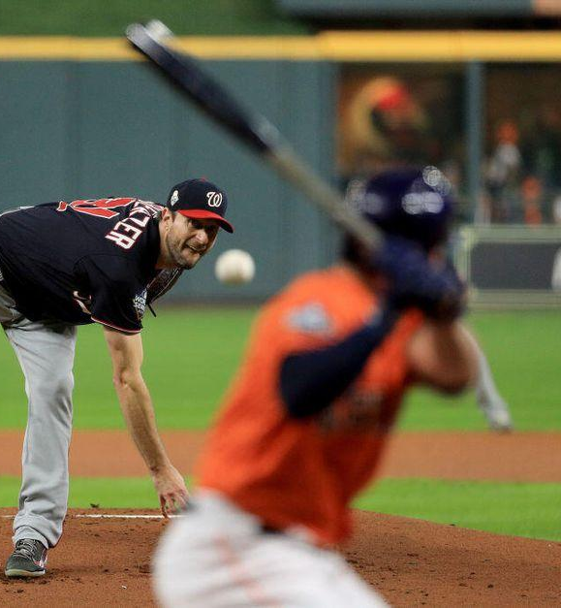

Notes:
One final word of encouragement. Evangelism is not like high diving. In high diving, you have to triple twist, flip, hit the water perfectly, no splash. You strive to be perfect. Evangelism is not like that. Evangelism is like baseball. You get up to the plate, you swing and miss, you strike out. Bummer. You get up to the plate a second time, you swing and miss, you strike out. Bummer, two in a row. You get up to the plate third time, you get a single. What’s your batting average that day? Two strike-outs and one single is a .333 batting average, which is All-Star level. Evangelism is like baseball. Get up to the plate, try some stuff, make some mistakes, get a single. Please teach your students to have fun with invitations. Don’t try for the perfect pitch. It doesn’t exist. Let’s just exhale and let’s help people be faithful witnesses.
Let’s close in listening prayer. God, what do you want to say to me today from this? (Pause)
TURN TO YOUR NEIGHBOR: What was your favorite part of today?

Slide 17
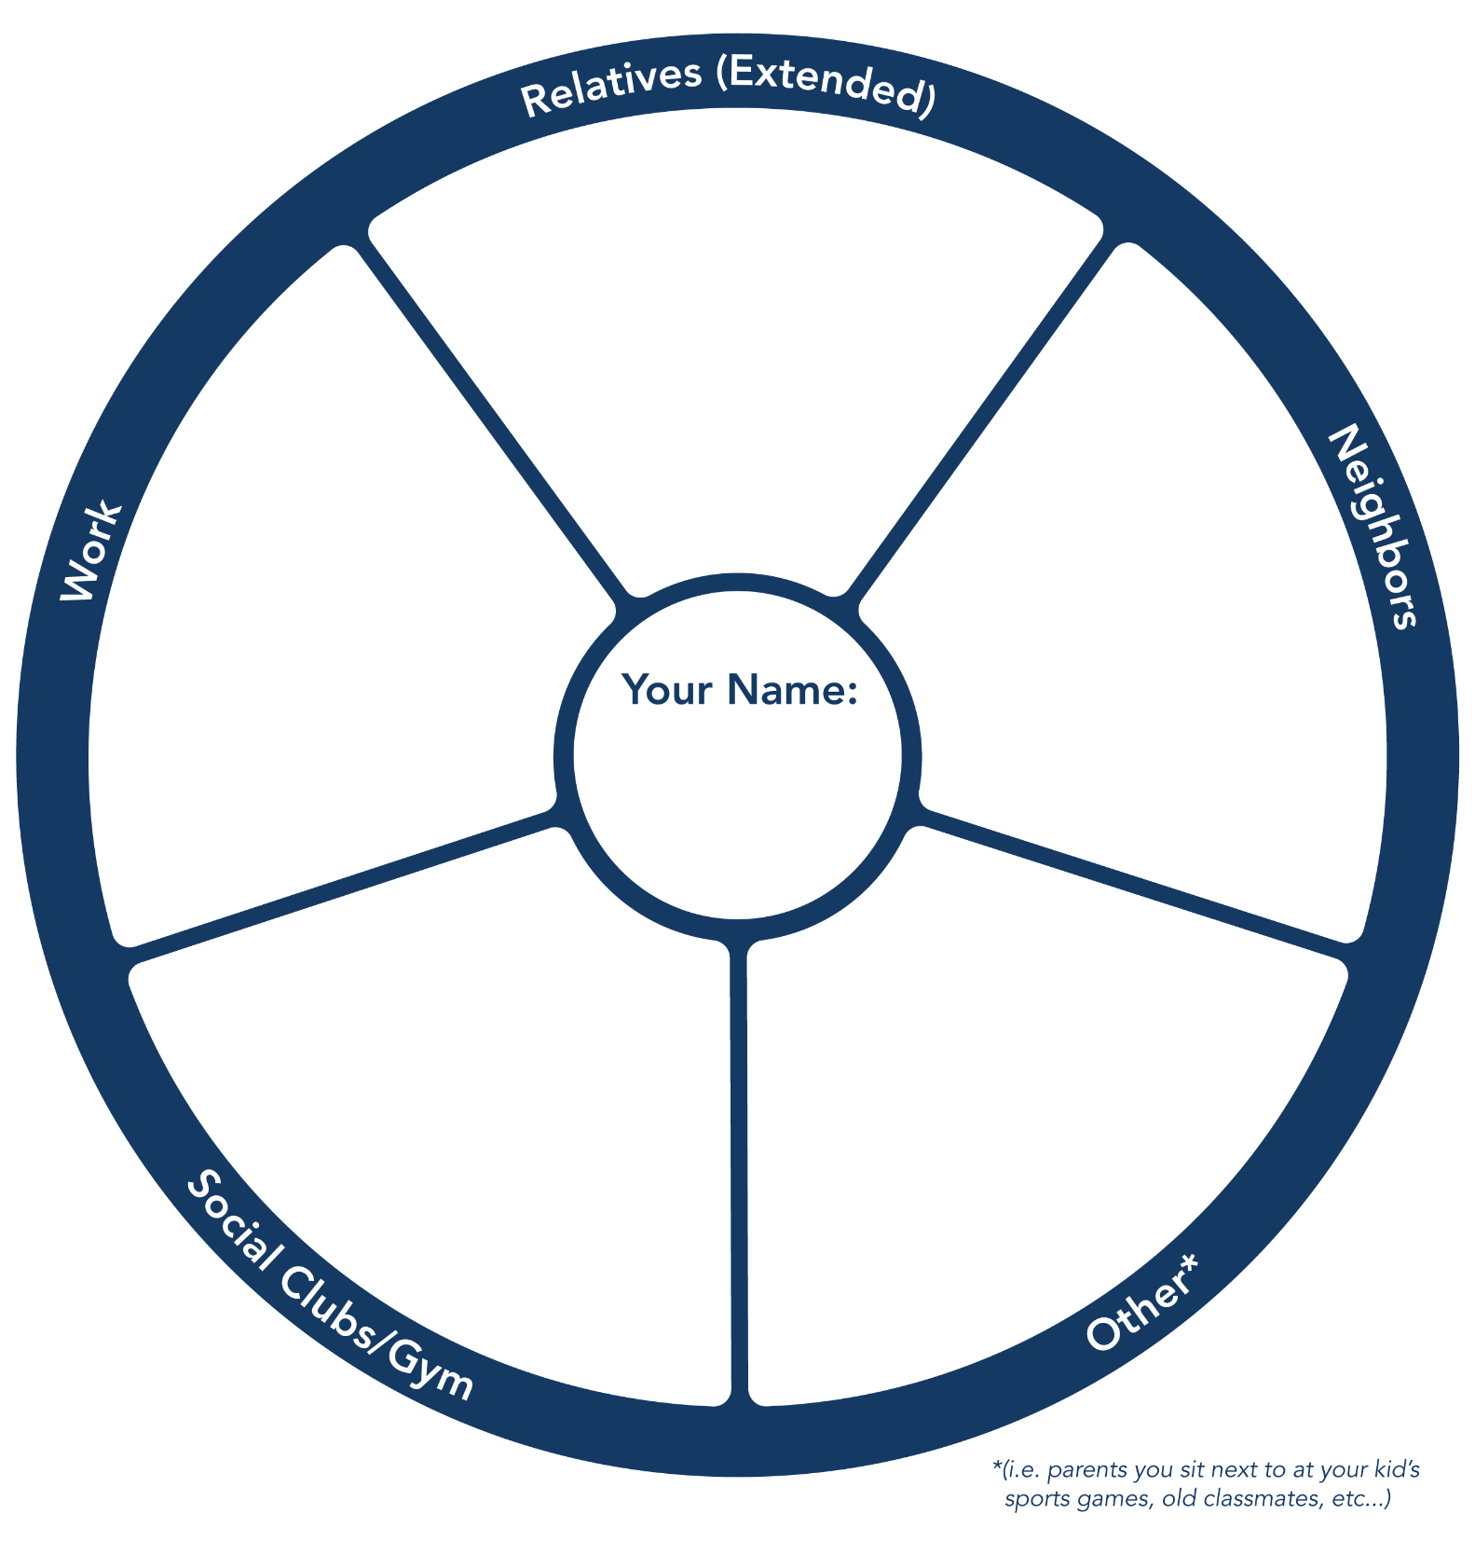

Notes:
Let’s pray for your friends and acquaintances. God is at work somewhere in your networks. Let’s pray for an adventuresome attitude, for eyes of faith and hearts of love. As we take small steps of faith and make invitations, God will show up and surprise us!

