Slide 1

Relational Evangelism Training
Session #5

Slide 2

Mentoring New Believers
Following Jesus after the Thresholds
Relational Evangelism Training Session #5
Notes:
“Before we get into the content of our final training on Relational Evangelism, what has been your favorite part so far? What has been helpful?”
“Today we wrap up the 5 Thresholds. What shall we do when we see fruit and people begin to follow Jesus?”
TIPS FOR THE TRAINER
Tell one story about how you have personally grown through the process of training on relational evangelism.

Slide 3

Our 5 Trainings
Mentoring
New Believers
Invitations that
Change Lives
Asking
Good Questions
The 5 Thresholds
of Faith
God does the Work
Notes:
As you will see, these five trainings are a helpful combination of Biblical concepts about evangelism, along with very practical workshop sections in which you get to try on the ideas for yourself. The goal is to equip us to live out these principles. ”
TIP FOR TRAINER
You and your church may decide to only offer a few of the trainings, and that is fine. Each one can be used as a “stand alone” session. You may also wish to reverse the order, given your needs. Although they have been created to build naturally upon one another, this is not required.

Slide 4

²⁵ The woman said, “I know that Messiah” (called Christ) “is coming. When he comes, he will explain everything to us.”
²⁶ Then Jesus declared,
“I, the one speaking to you— I am he.”
Notes:
“Let’s go back to John 4. The Samaritan woman reveals her longing for the Messiah and Jesus reveals himself to her.
What does this new believer do next?”

Slide 5

²⁸ Then the woman left her water jar and went back to the city. She said to the people, ²⁹ “Come and see a man who told me everything I have ever done! He cannot be the Messiah, can he?” ³⁰ They left the city and were on their way to him.
Notes:
“She leaves her jar behind. Her joy overflows. She immediately shares her story with her neighbors, ‘Come see this man who told me all I’ve ever done. Could he be the Messiah?’
She has known Jesus less than one day. She is no theology expert. And yet she tells her story of encountering Jesus.
We too want to help new believers tell their stories of new faith, as soon as possible. Mentoring makes this much more possible.”

Slide 6

³⁹ Many Samaritans from that city believed in him because of the woman’s testimony, “He told me everything I have ever done.”
⁴⁰ So when the Samaritans came to him, they asked him to stay
with them; and he stayed there two days. ⁴¹ And many more
believed because of his word.
Notes:
“This woman’s simple testimony impacted the all her neighbors. As she speaks, faith is not far off. Faith is up close and personal and attractive. This is the electrifying impact of new believer testimonies. Thank God for her courage.
What would our community be like if everyone new believer had the support to share their story within weeks of their encounter with Jesus? What if we saw a ripple effect of renewed faith?
TIPS FOR THE TRAINER
If you will train all five sessions, you might say, “In Session 5, we will go deeper on this theme of new believers sharing their stories.”

Slide 7

Empathy for New Believers
Notes:
“Almost no one is like the Samaritan woman. The faith of new believers is often wobbly, like a baby giraffe, learning to use their legs for the first time. Faith feels wobbly and unfamiliar.
Let’s have compassion. They have many questions, both profound and logistical. How does one pray? How can I be successful at faith? Where is the bathroom?
For those of us who have been going to church for decades, we forget how odd it can be at first. Our songs are unknown, our language archaic, and our traditions seem mysterious. They need a friend to help them interpret our church culture.
Don’t be surprised by their confusion about Lordship, their weak theology, or their overly-busy lives which keep them from attending church regularly.

Slide 8
BRAINSTORM:
What do new believers need?
Notes:
“Let’s brainstorm: in table groups, what do new believers need from us to grow and thrive?”
TIPS FOR TRAINERS
There are no right answers here. We are helping people wrap their minds and hearts around serving new believers when they begin to follow Jesus.

Slide 9

Notes:
“Let’s see what InterVarsity gives to new believers. We will review their mentoring guide, and decide for ourselves if we like it or prefer mentor new believers another way.”
Fresh Faith introduces the five essential habits that help us thrive in faith, with very practical applications suggested to live out each of the five bible studies. New believers will not just get more knowledge, but a new lifestyle of living out the Word of God. We will prepare you to walk alongside them and help them flourish as they live out these new habits.
TIPS FOR TRAINERS
Beforehand, decide with your Pastor if you will use Fresh Faith for mentoring new believers, or if you have another curriculum you will use.
Also, review p. 128 from I Once Was Lost for more on these five crucial habits for new believers.

Slide 10
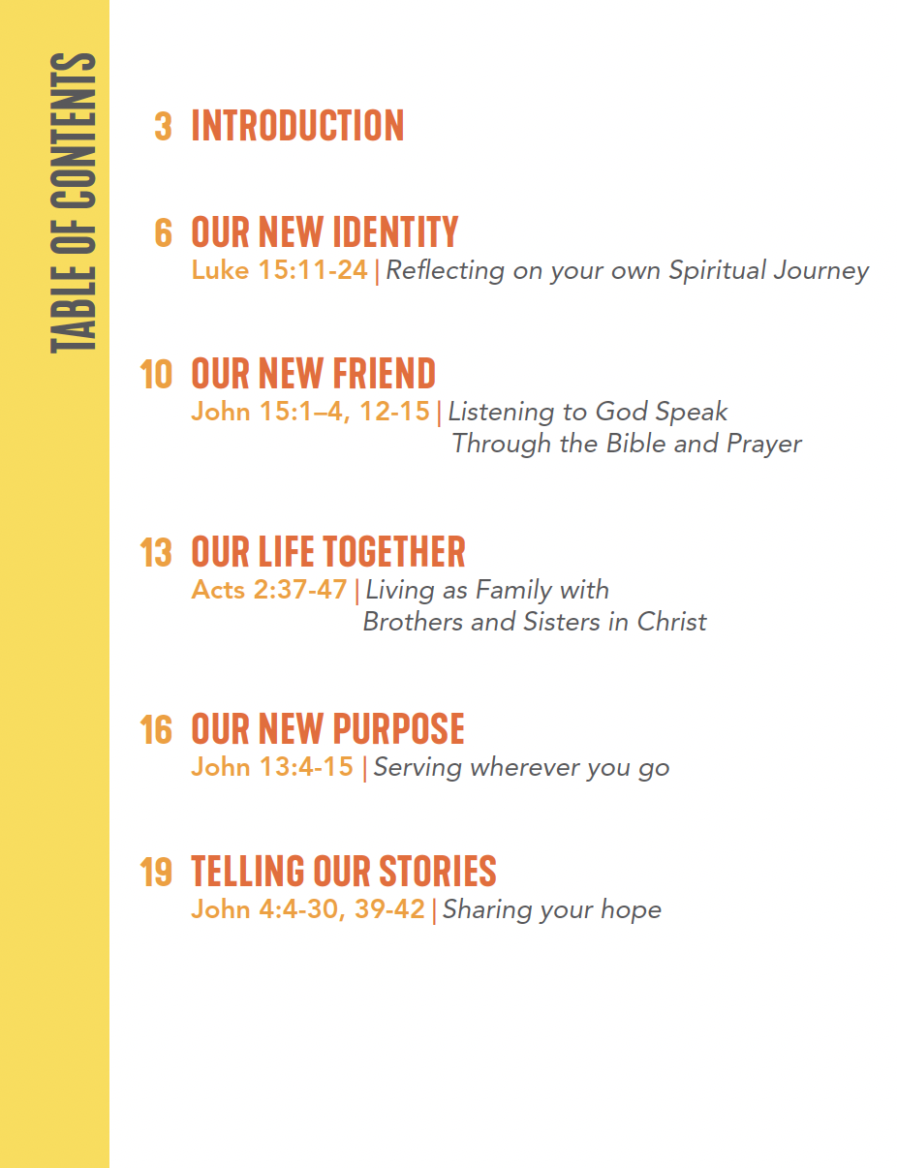

Slide 11

3 Habits of a Faithful Mentor
Show up and pray
Ask questions
Introduce them to others at church.
Notes:
“We hope that some in our community will volunteer to mentor faithful mentors, if we so choose. We will walk through exactly what it means, and you will receive an overview of an easy-to-use New Believers Bible study.
There are three essential components to being a faithful mentor.
Show up at the scheduled times, and pray for them on your own.
Ask question. Help them explore faith. Please do not lecture.
Introduce them to others at church. Help them connect in your community.
Before we dial into each of these, let’s hear from Jesus himself. Jesus has very important instructions for us about mentoring new believers.”

Slide 12

3 Common Barriers to Mentoring New Believers
“I don’t know my Bible well.”
“I’m not holy or mature enough.”
“I’m too busy!”
Notes:
“You might be thinking, ‘Who me? A mentor?’
“There are 3 common barriers to mentoring new believers.
No seminary skills. You feel a lack of knowledge. ‘What happens when they ask me a question I cannot answer?’
Why me? I’ve never been mentored. I don’t know what I’m doing? Just send them to Sunday School!
I’m busy. My life is full. I’m already serving coffee on Sundays.
Sometimes we try to replace mentoring with merely sending people to a new members class, and expecting them to automatically attend Sunday worship. This was never Jesus’ original game plan for us.
Let’s invite the Holy Spirit to change our hearts and refresh us with love.

